Slide 1
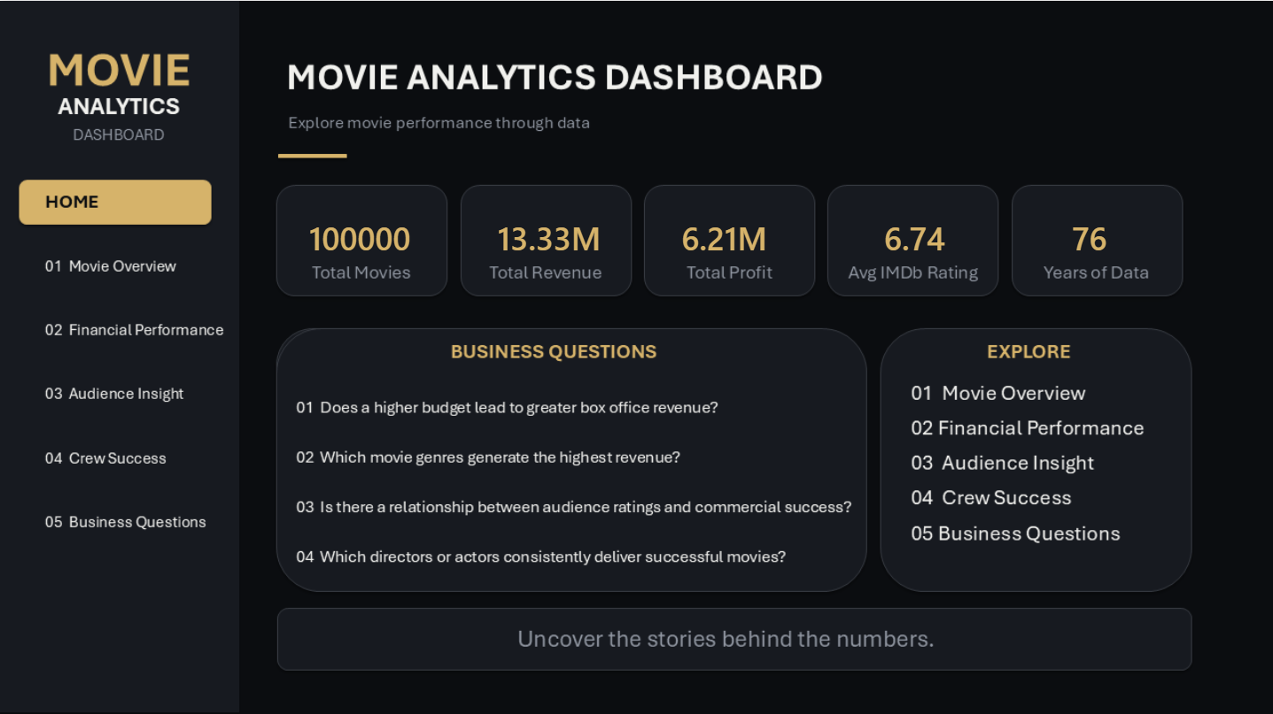
INSIGHTNEST | TEAM 3
Global Movie Success Analysis
Understanding the factors associated with commercial success
Python EDA • Power BI • Business Insights
TEAM 3
Keshav Baheti Piyush Dave

Slide 2
02
Business Problem & Project Objective
What are we trying to understand?
BUSINESS PROBLEM
OBJECTIVE
Movie success depends on multiple factors. This project analyzes financial performance, genre, audience reception and crew performance to identify patterns associated with commercial success.
Identify factors associated with movie commercial success using publicly available movie data and convert findings into actionable business insights.
FOUR BUSINESS QUESTIONS
01 Does a higher budget lead to greater box office revenue?
02 Which movie genres generate the highest revenue?
03 Is there a relationship between audience ratings and commercial success?
04 Which directors or actors consistently deliver successful movies?

Slide 3
03
Data Collection & Dataset
From raw movie data to an analysis-ready dataset
DATA SOURCE
KEY FIELDS
PREPARATION
Budget Revenue Profit ROI Genre / Sub-genre IMDb rating Audience score Meta score Director Actor Release year Popularity / awards / flags
Data Type: Publicly available movie data Source: Kaggle Dataset: Global Movies Dataset ( 1950 –2026 ) Dataset size: 100k+ records Period: 1950 – 2026 Kaggle: Global Movies Dataset 1950–2026
Python was used for data cleaning, EDA, outlier analysis and visualization. Revenue capping was used in the crew analysis to reduce the influence of extreme revenue values.

Slide 4
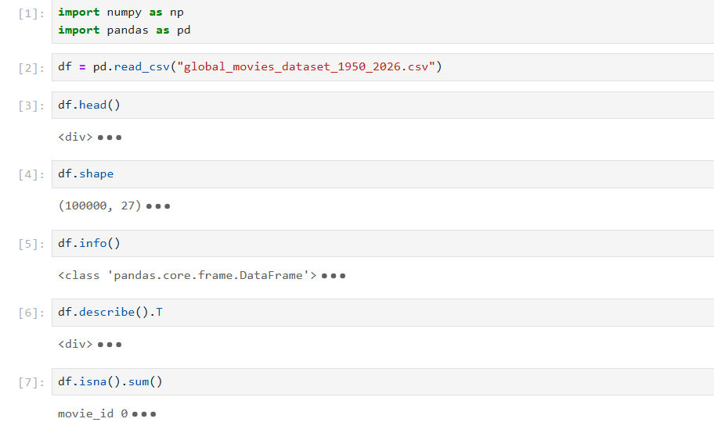
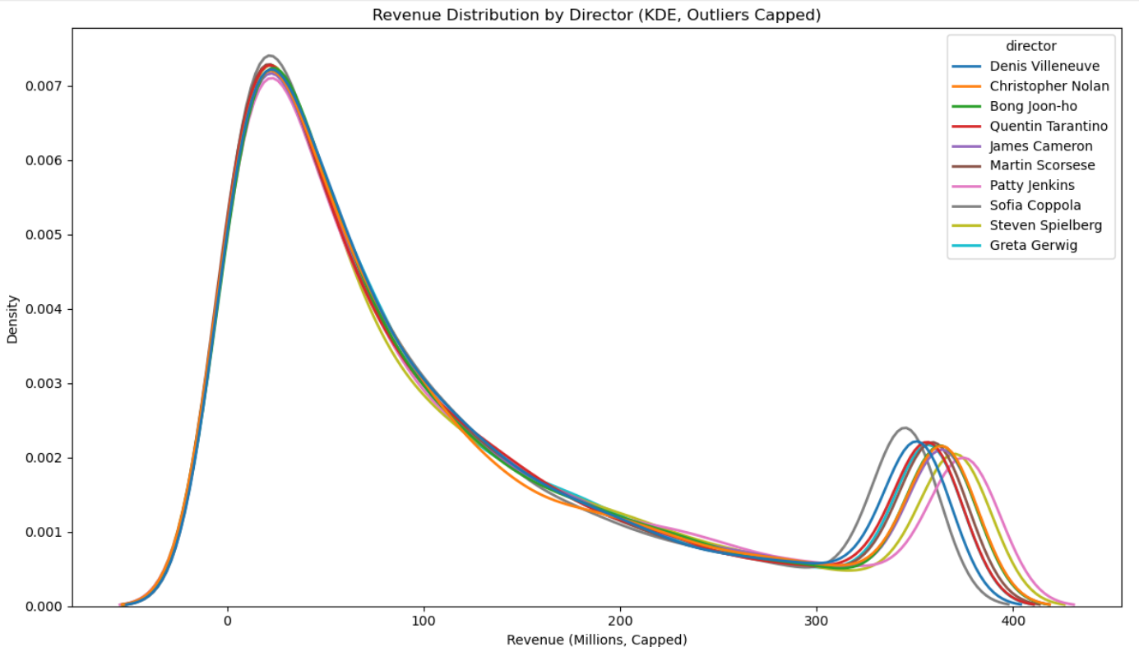
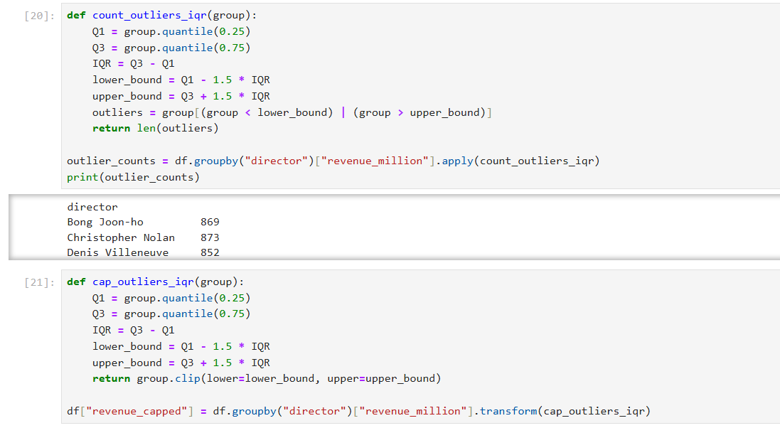
04
Python - Data Cleaning, EDA & Insights
How the dataset was prepared and explored
DATA CLEANING
Missing values | Duplicates Check | Data Type Check | Derived Measures like Profit | Prepared Data for Analysis
OUTLIER / REVENUE ANALYSIS
Revenue contained extreme values that could heavily influence comparisons. Therefore, revenue capping was applied for the actor/director analysis to reduce the impact of extreme observations.
PYTHON INSIGHTS
Python EDA was used to identify patterns in budget, revenue, genre, audience ratings and actor/director performance, which were then explored interactively in Power BI.

Slide 5
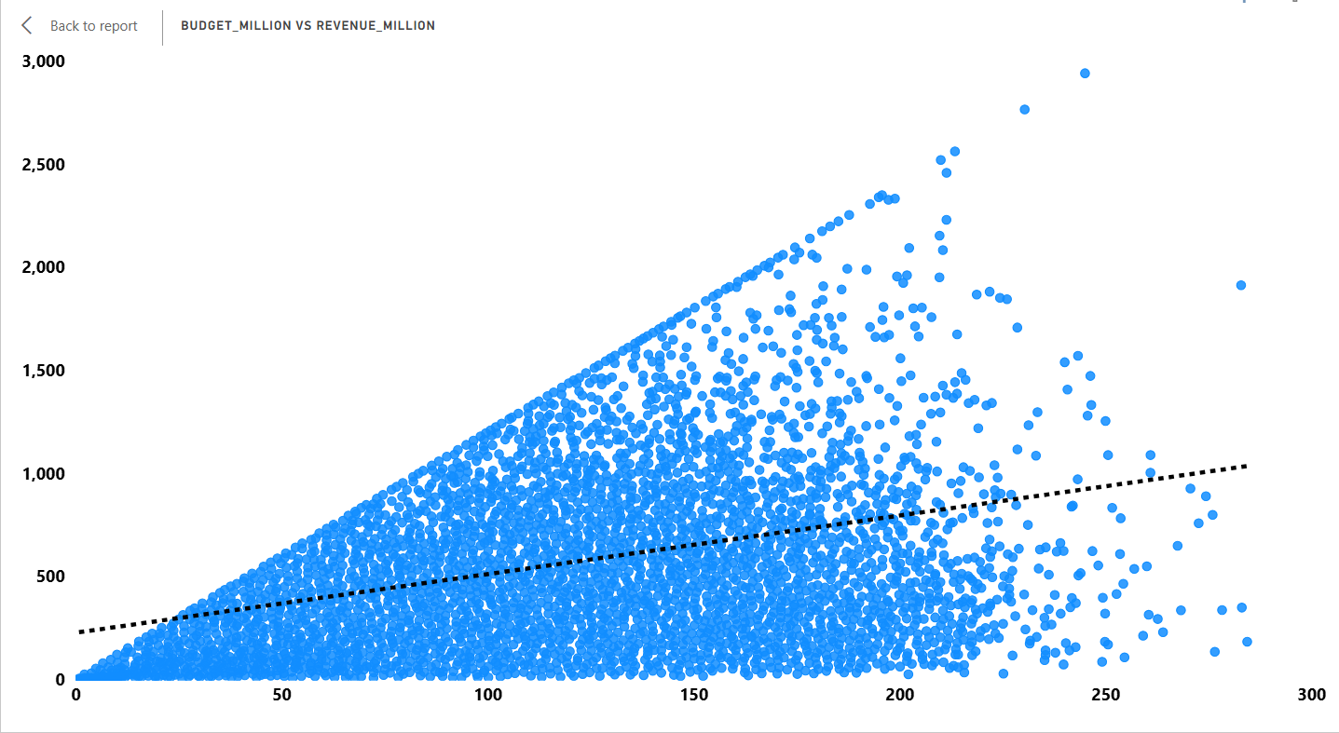
05
Q1 - Budget vs Revenue
Does a higher budget lead to greater box office revenue?
VISUAL LOGIC
Scatter plot X = Budget Y = Revenue Each point = one movie
KEY INSIGHT
Higher-budget movies generally tend to generate higher revenue, but budget alone does not guarantee commercial success as the dots are spread.
BUSINESS TAKEAWAY
Budget is an important factor, but investment decisions should consider other success drivers such as genre, audience reception, etc.

Slide 6
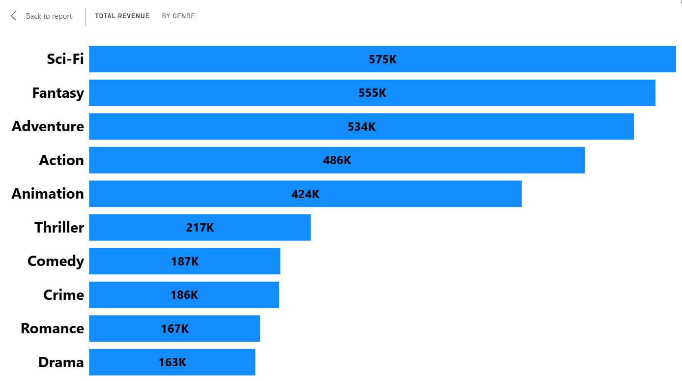
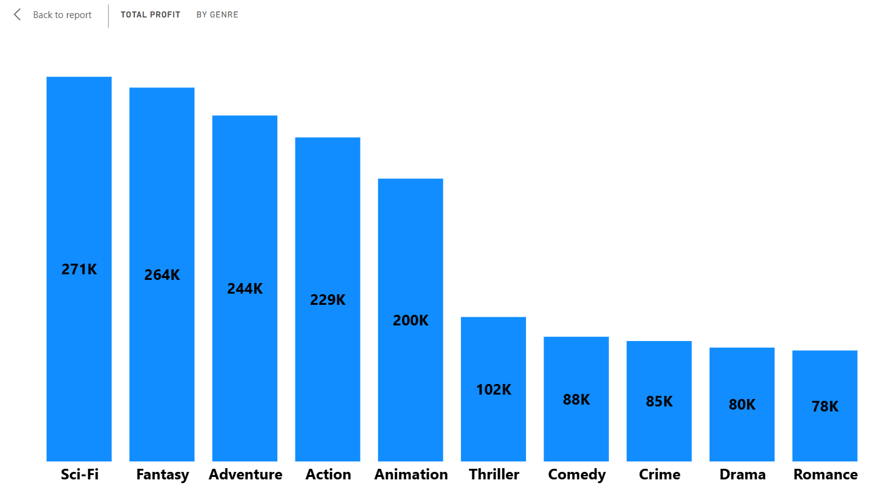
06
Q2 - Genre Performance
Which movie genres generate the highest revenue?
Top 10 Genre by Revenue & Profit
KEY FINDING
The two charts compare the top 10 genres based on total revenue and total profit. This helps distinguish genres that generate high sales from genres that generate high profitability.
Revenue leader: Sci-Fi , Fantasy , Adventure Profit leader: Sci-Fi , Fantasy , Adventure . Revenue and profit rankings show a very similar pattern, with only the lower-ranked genres changing positions.

Slide 7
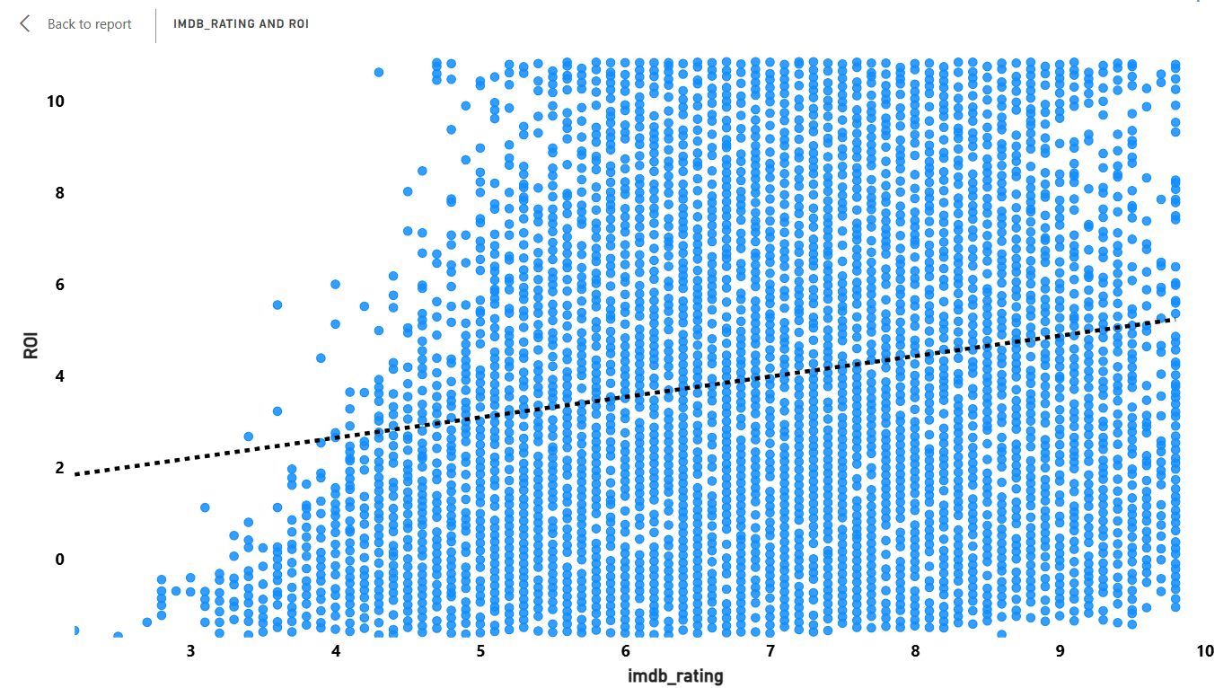
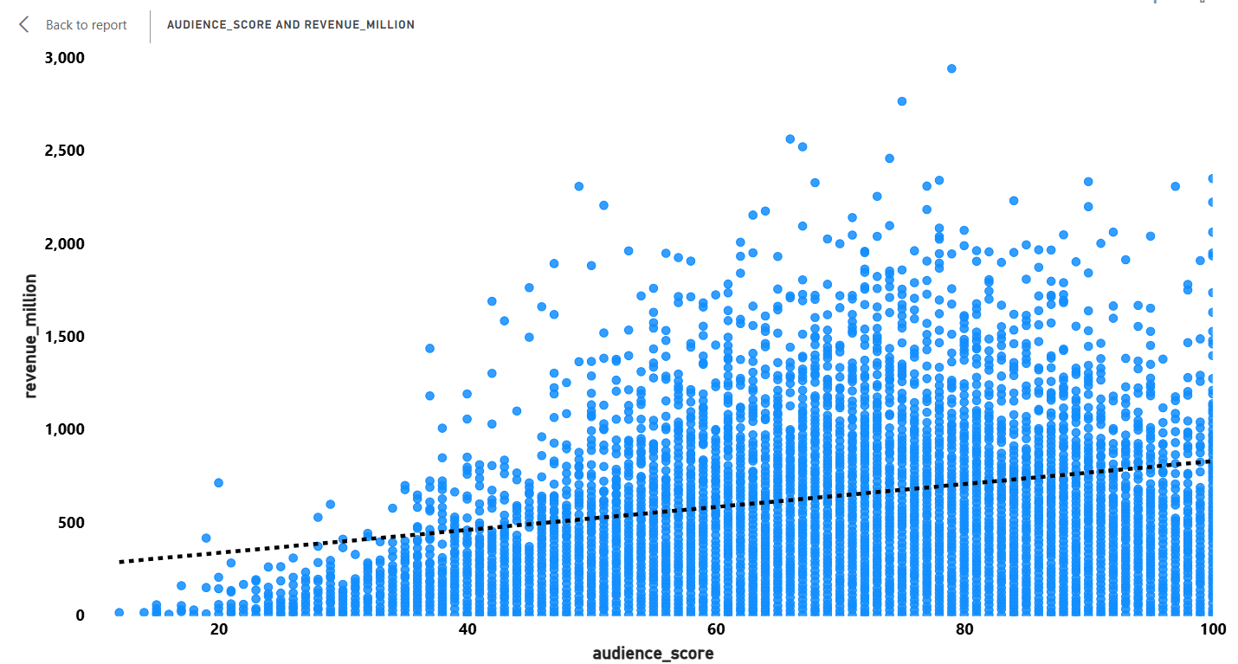
07
Q3 - Audience Ratings & Commercial Success
Is there a relationship between audience ratings and commercial success?
AUDIENCE SCORE VS REVENUE
Paste Page 3 chart
IMDB Rating vs ROI
Audience Score vs Revenue
The visuals suggest that better audience reception is generally associated with stronger commercial performance, while IMDb ratings also show a relationship with ROI. However, the relationship is not absolute, indicating that ratings alone cannot determine a movie's commercial success.
CONCLUSION

Slide 8
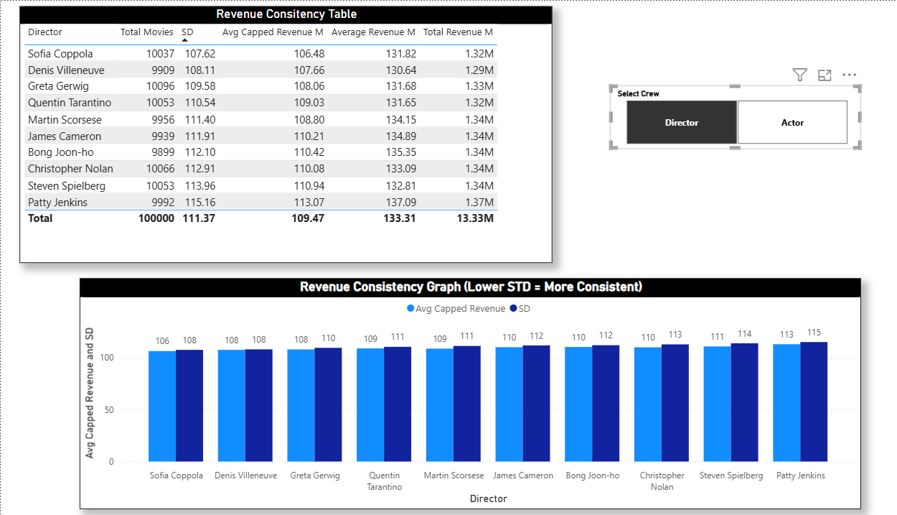
08
Q4 - Crew Success
Which directors consistently deliver successful movies?
Conclusion
The analysis shows that Patty Jenkins has the highest average capped revenue, indicating strong commercial performance. However, her higher revenue variation suggests that this success is not always consistent. Sofia Coppola shows comparatively lower but more stable performance. Overall, average revenue alone is not enough to measure consistency. A success-rate analysis based on a defined revenue threshold would provide a stronger business insight.

Slide 9
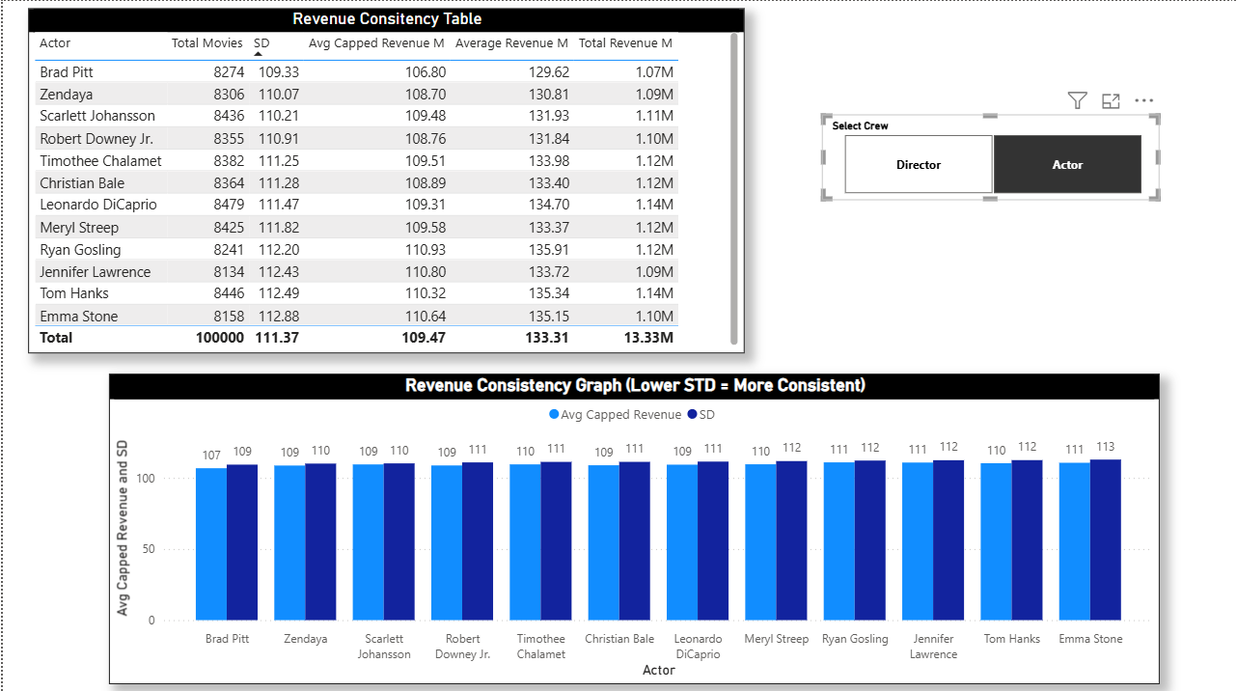
08
Q4 - Crew Success
Which actors consistently deliver successful movies?
Conclusion
The analysis shows that Emma Stone has the highest average capped revenue, indicating strong commercial performance. However, her higher revenue variation suggests that this success is not always consistent. Brad Pitt shows comparatively lower but more stable performance. Overall, average revenue alone is not enough to measure consistency. A success-rate analysis based on a defined revenue threshold would provide a stronger business insight.

Slide 10
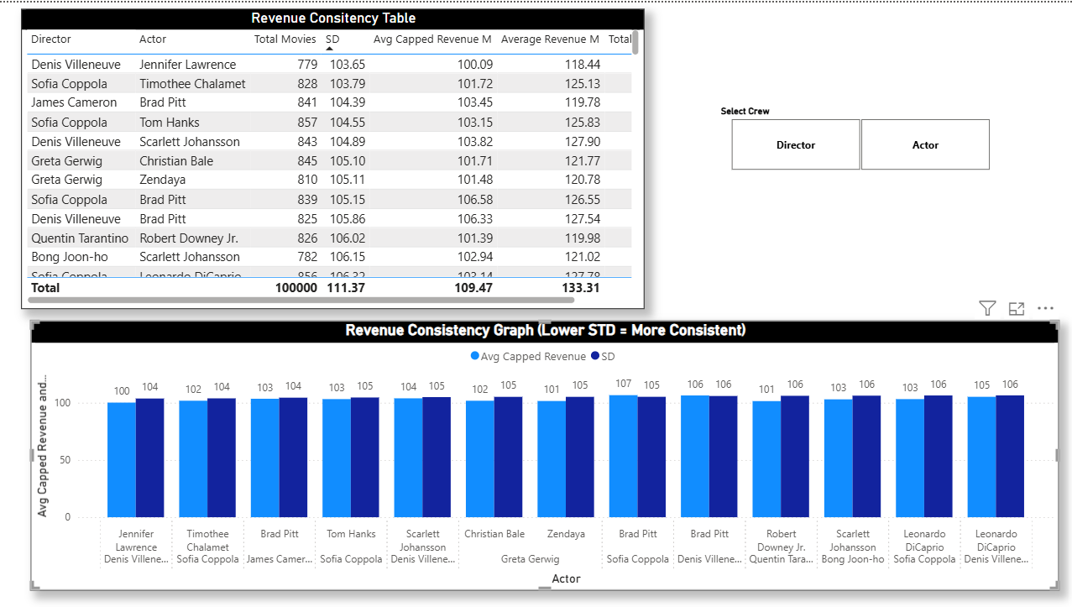
08
Q4 - Crew Success
Which actors and director both consistently deliver successful movies?
Conclusion
The analysis shows that Leonardo Dicaprio , Denis Villeneuve has the highest average capped revenue, indicating strong commercial performance. However, her higher revenue variation suggests that this success is not always consistent. Jennifer Lawrence , Denis Villeneuve shows comparatively lower but more stable performance. Overall, average revenue alone is not enough to measure consistency. A success-rate analysis based on a defined revenue threshold would provide a stronger business insight.

Slide 11
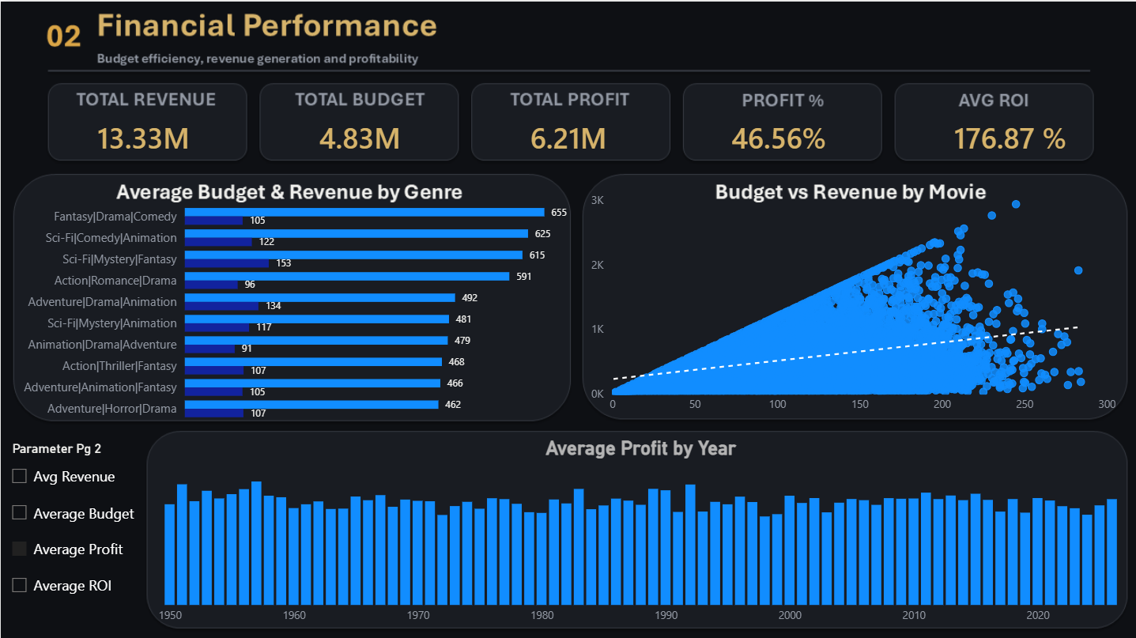
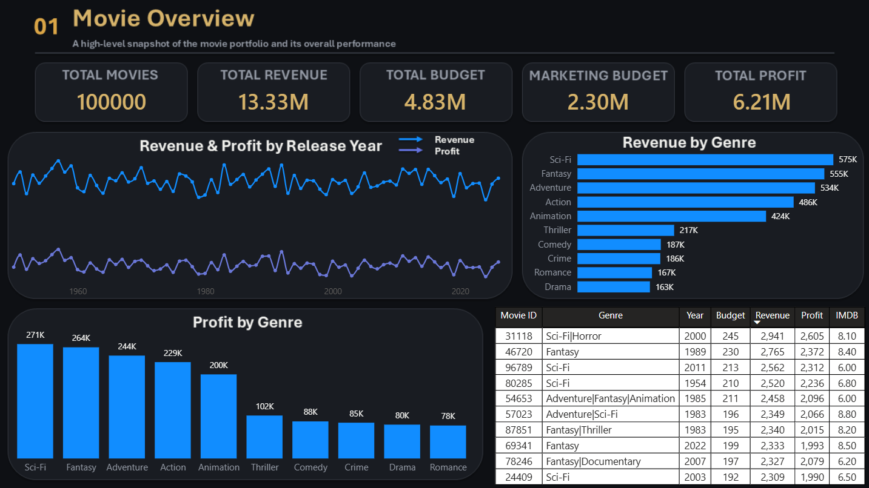
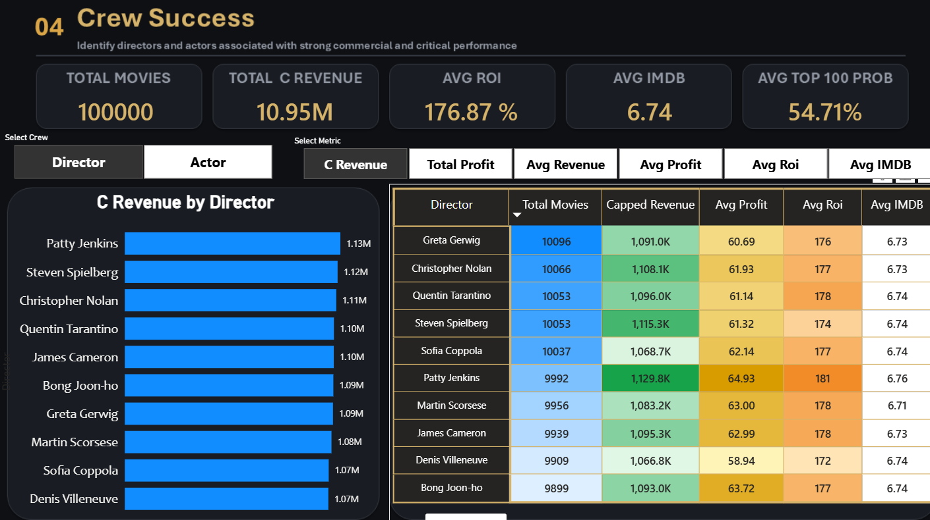
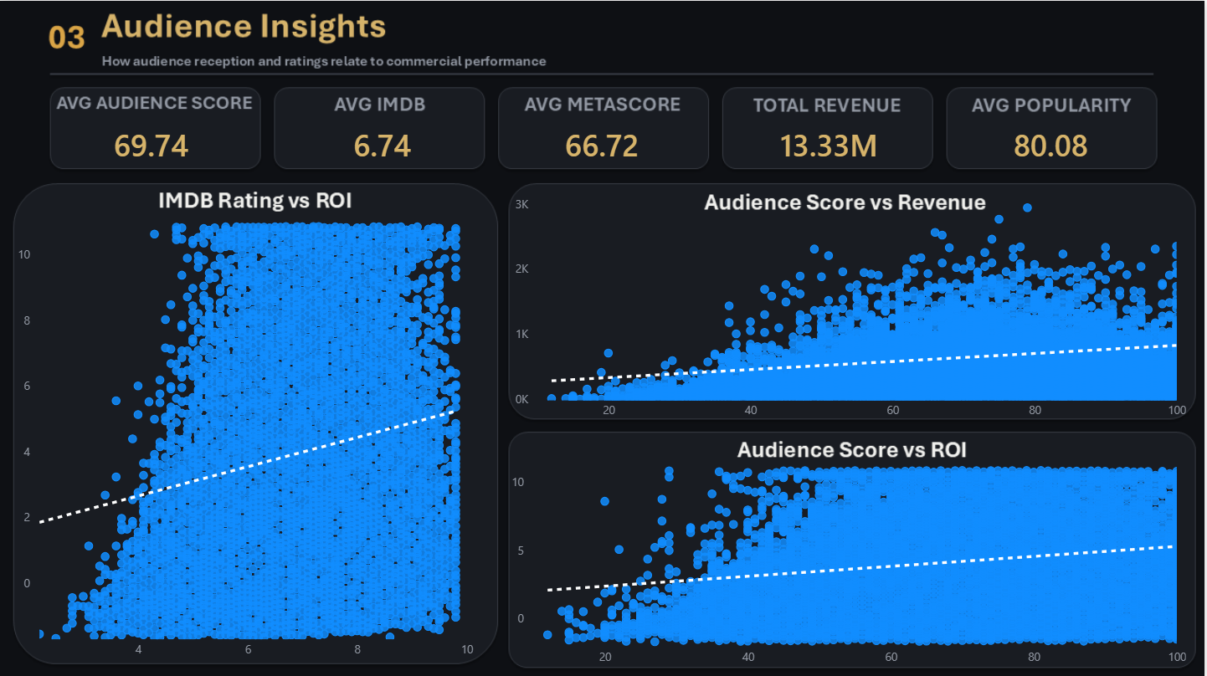
09
Power BI Dashboard
Interactive analysis across four business questions

Slide 12
10
Key Insights & Findings
What did the combined analysis tell us?
FINANCIAL
GENRE
Higher-budget movies generally tend to generate higher revenue, showing a positive relationship between budget and box office performance. However, the relationship is not absolute, indicating that budget alone does not guarantee commercial success.
Sci-Fi, Fantasy and Adventure are among the leading genres in both revenue and profit. The rankings are largely consistent across both measures, with only minor changes in the lower-ranked positions.
AUDIENCE
CREW
Higher audience scores show an association with higher revenue, while IMDb ratings show an association with ROI. This indicates that audience reception and ratings can support commercial performance, but they alone cannot determine a movie's success.
Sofia Coppola / Brad Pitt stands out in the director / actor analysis across key financial measures, particularly revenue, profit and ROI. Sofia Coppola and Brad Pitt show strong consistency, based on their relatively lower standard deviation across revenue, profit, and ROI.

Slide 13
11
Business Recommendations & Conclusion
Turning analysis into decisions
01 BUDGET DECISIONS
02 GENRE STRATEGY
03 TALENT & AUDIENCE
Budget should be considered an important investment factor, but not the only predictor of success. Movie projects should also consider genre, audience reception and talent performance.
Revenue and profit performance should both be considered when selecting genres. Genres showing strong performance across both measures can provide better commercial potential.
Actors and directors should be evaluated using multiple metrics such as revenue, profit, ROI and IMDb rating. Audience reception can also be considered as a supporting indicator of potential success.
FINAL TAKEAWAY
Movie success is multi-factor: financial investment, genre, audience reception and crew performance provide complementary signals.

